Slide 1
Computer Architecture: Exceptions & Interrupts Part 1: Modes, Frames, C Code
Dr. Colin O’Flynn

Slide 2
Lectures
How does a program run on a machine?
How do you compile from high-level code to machine code?
How do you observe the machine running?
How do we define the machine?
How does the machine control flow change (planned)?
How does the machine control flow change (unplanned)?
…at some point: what is the most basic possible machine…

Slide 3
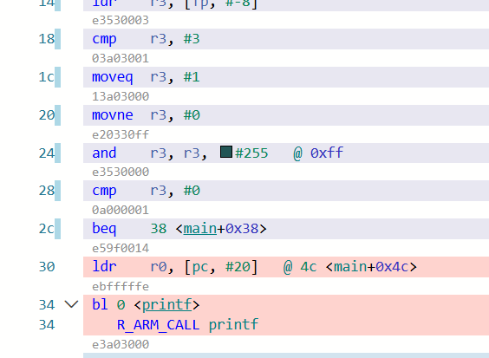
Control Flow So Far
Linear Flow
Branches (“beq”)
Subroutine calls (“bl”)
All of these are explicit & software-initiated.

Slide 4

Our Saviour: Exceptions
IRQ
How do we make control flow change without a software-initiated request?
If software had to initiate every change we would need to poll for every possible scenario.

Slide 5
Interrupts vs. Exceptions
Exceptions & Interrupts both result in hardware-level control flow change
Interrupts are typically caused by some “external (to the CPU) event” (pin change, timer)
Exceptions are typically caused by the CPU itself

Slide 6
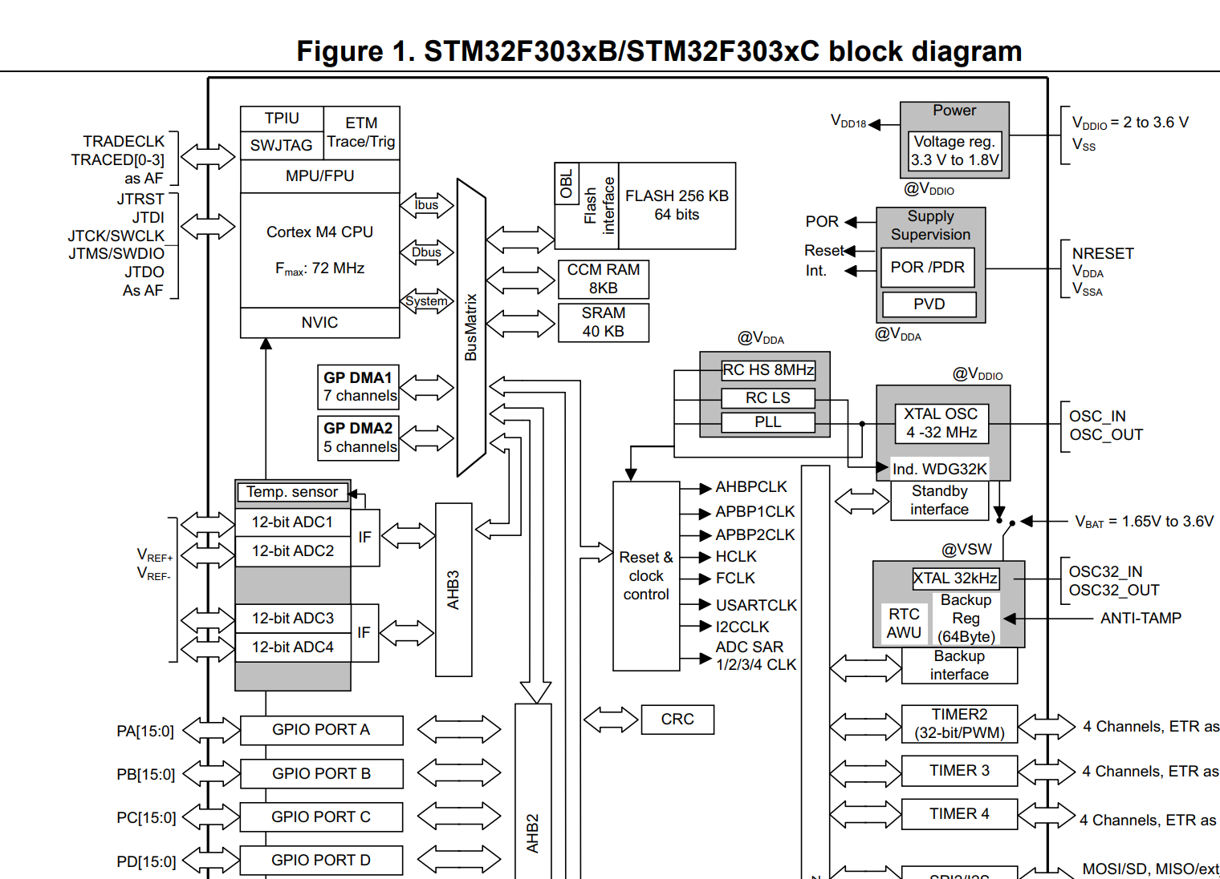
What is the CPU?

Slide 7
Interrupt Vector Table
Most (all?) processors have some form of a vector table which defines where control is transferred on an interrupt/exception.
The level of hardware support is defined by the ISA.
Some processors at the hardware level are very simple – rely on a user to decode which interrupt triggered and call further routines.
Slower to pass control to a specific routine.
Some processors (e.g., Arm) are more complex and have very specific tables.
Faster to pass control to a specific routine.

Slide 8
Fast vs. Slow

Slide 9
Interrupt Address: In Table vs. Program Memory
Some devices pass execution to the vector table location
You need to have a “jmp” instruction there to pass control where you want.
Some devices have an address in the vector table which tells the CPU where to pass control.

Slide 10
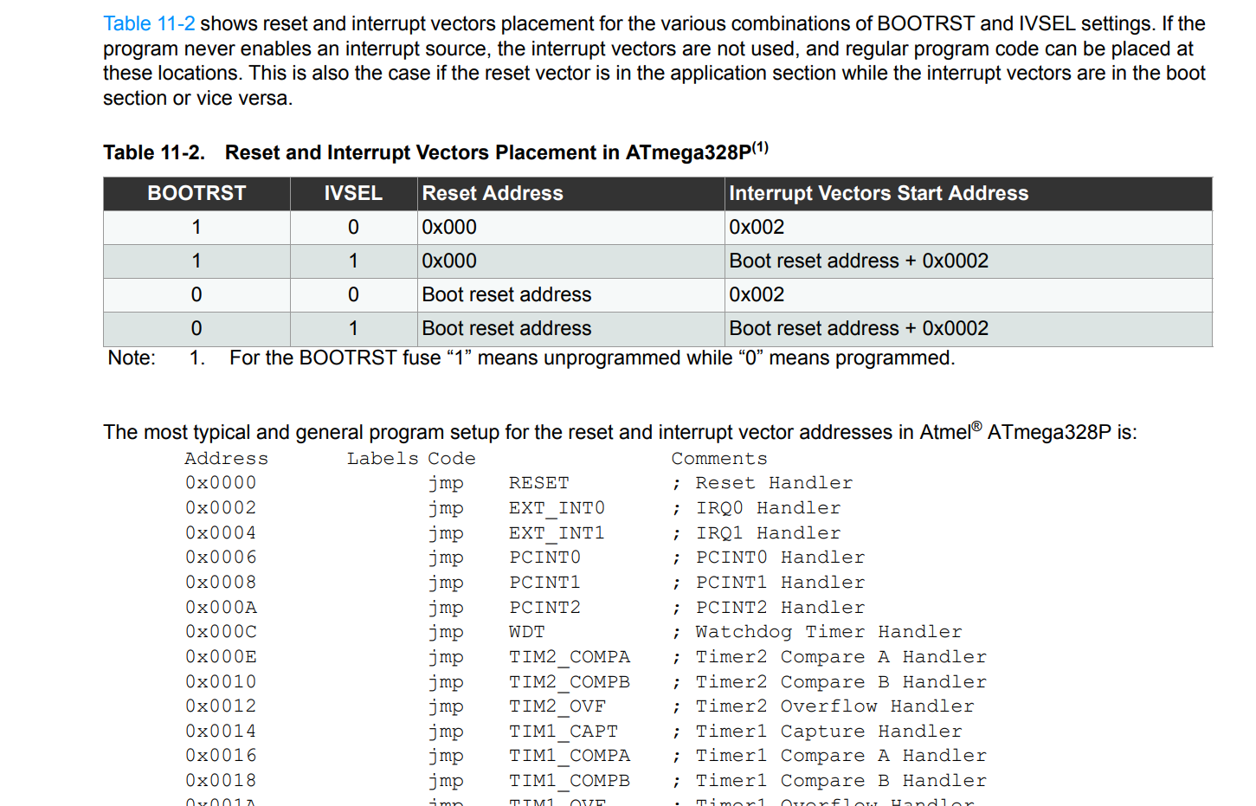
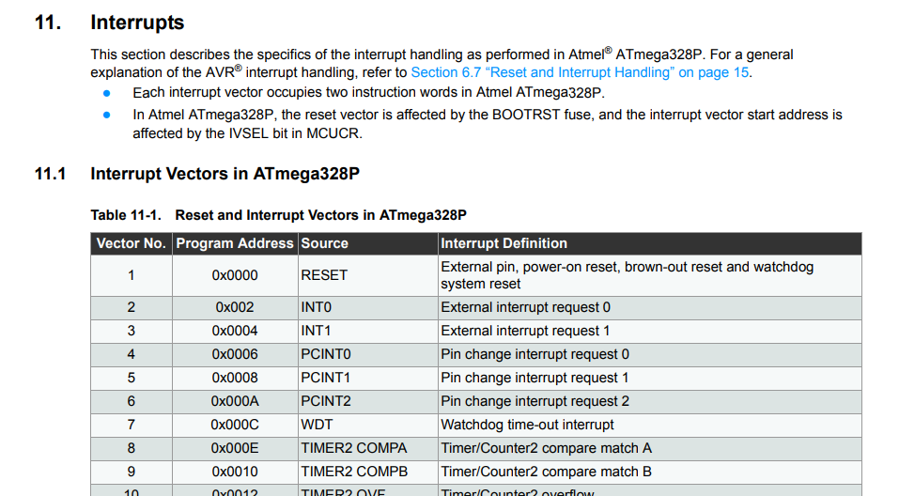
e.g., AVR: Code in vector table
https://ww1.microchip.com/downloads/en/DeviceDoc/Atmel-7810-Automotive-Microcontrollers-ATmega328P_Datasheet.pdf page 49+50

Slide 11
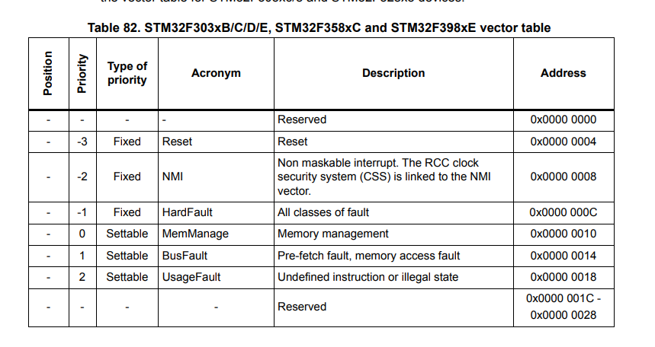
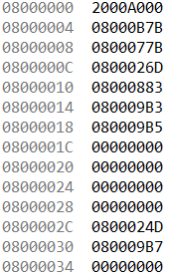
e.g., ARM: Addresses in vector table
Address Contents

Slide 12
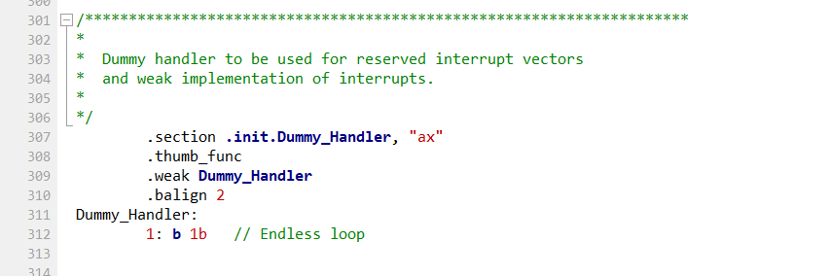
Default Interrupt Handler?
Very common that systems have a default handler. May be used as one for everything or one per interrupt.
May be an endless loop (will STOP execution) or a silent return.

Slide 13
Normal Interrupt Types
Non-Maskable Interrupt (NMI)
This interrupt cannot be “turned off” (masked)
Maskable Interrupt (aka everything else)
Interrupts are normally asynchronous as they are external to the instruction stream (generated outside CPU)

Slide 14
Exception Types
Exceptions are normally synchronous as generated by CPU
Faults such as:
Invalid instructions
Invalid memory access
Divide by zero
Software Interrupt (SWI) used for control flow

Slide 15
e.g., STM32F3 NVIC Vectors

Slide 16
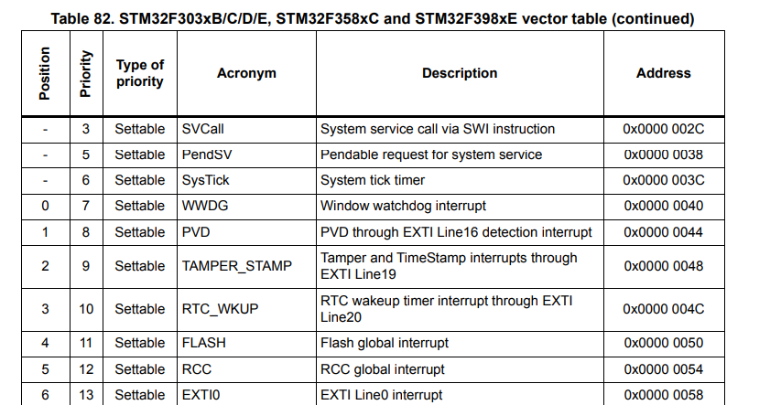
e.g., STM32F3 NVIC Vectors

Slide 17
Exceptions Defined in the ISA
Exceptions / Interrupts are required to deal with:
I/O handling
Error handling
Real-time requirements
Work-arounds for a non-exception processor:
Registers store state of things to deal with
Need to poll these registers – either spend lots of time polling or have long response times.

Slide 18
Exceptions & Jumps
Exceptions are a hardware-initiated subroutine call with some level of automatic “context saving”

Slide 19
Interrupt Handlers in C Code
Most frameworks will have some way of setting up interrupts.
This is often different per architecture, compiler, and even framework.
See documentation – I’ll be showing you the most basic way here.
Often framework uses a __weak__ attribute to make life easier

Slide 20
e.g., Demo of Exceptions in C Code
Things to cover (notes to self)
Interrupt table example
C __weak__ attribute
Calling function and overriding the __weak__

Slide 21
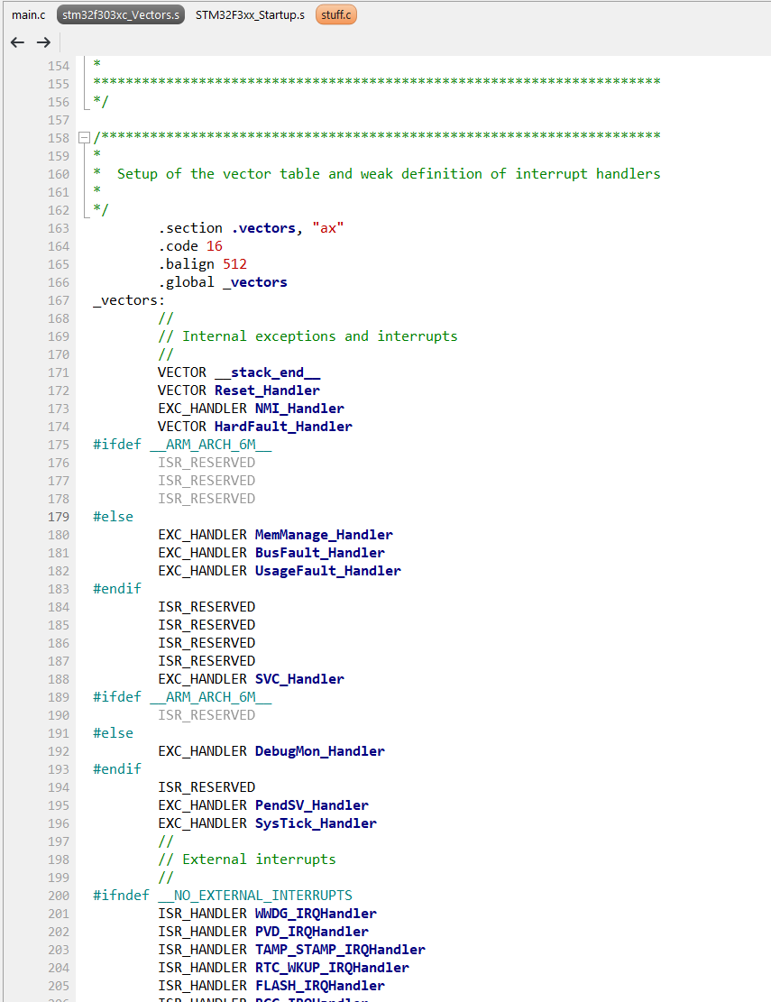
Vector File

Slide 22
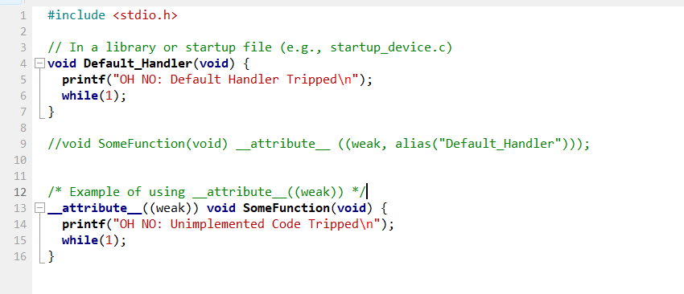
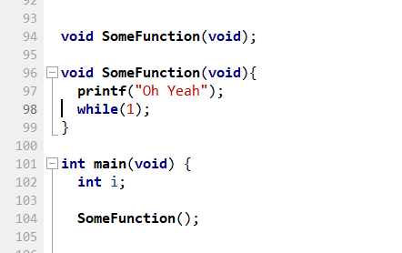
(Notes to Self)
Add a file to project (stuff.c)
In main.c

Slide 23
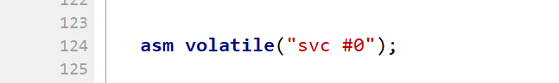
(Notes to Self)
asm volatile("svc #0");

Slide 24
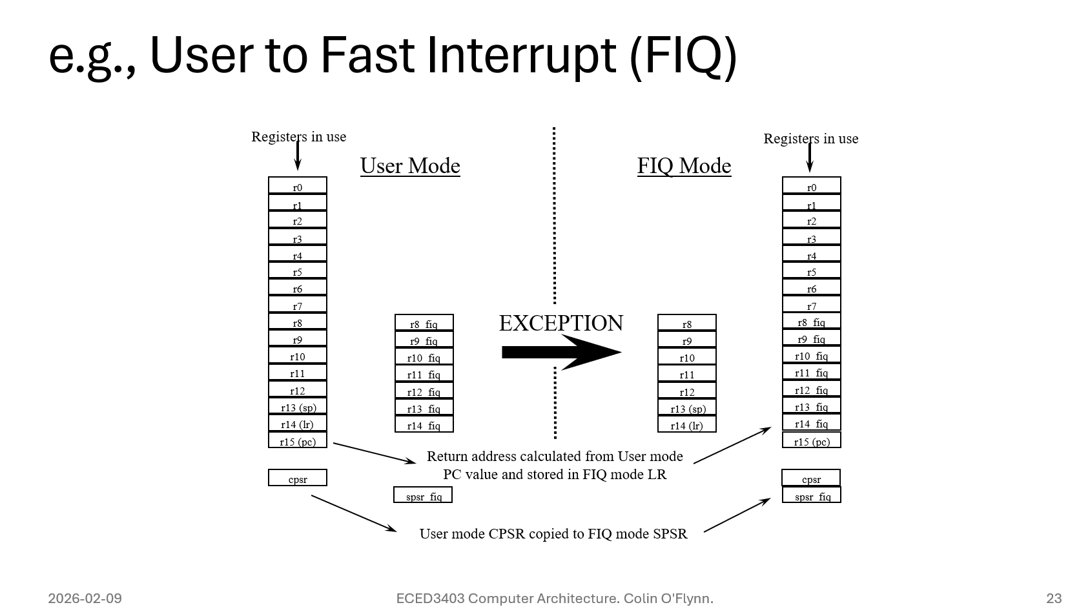
Interrupt Context
From lecture on ISA:
Cortex-M has a much simpler interrupt handler without register banks.

Slide 25
Interrupt Context
Cortex-M operate in two modes:
Thread Mode:
Can run in both unprivileged & privileged mode
Handler Mode:
Always in privileged mode – full access to registers, memory etc

Slide 26
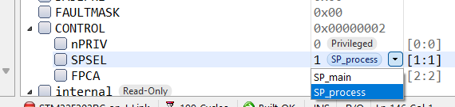
Stack Pointer Switching
Cortex-M has two “stack pointers” – this just banks out r13 (SP).
Compiling normal code always uses SP_main (even in interrupt)

Slide 27
Stack Pointer: Main vs. Process
A RTOS will normally use Main Stack Pointer (MSP) for the Kernel, and Process Stack Pointer (PSP) for the processes.
The interrupt handler uses the current stack pointer to save state, then switches to the main stack pointer then returns to the previous stack pointer mode.
This can be confusing if using both modes!

Slide 28
e.g., Demo of Exception Context (Notes to Self)
Overwriting r15
Overwrite r13 after changing main vs. process mode
Show stack in both modes when calling interrupt
Show registers being pushed onto stack

Slide 29
e.g., Demo of Exception Context
asm volatile("ldr r0, =0x01010101");
asm volatile("ldr r1, =0x02020202");
asm volatile("ldr r2, =0x03030303");
asm volatile("ldr r3, =0x04040404");
asm volatile("ldr r4, =0x05050505");
asm volatile("ldr r5, =0x06060606");
asm volatile("ldr r6, =0x07070707");
asm volatile("ldr r7, =0x08080808");
asm volatile("ldr r8, =0x09090909");
asm volatile("ldr r9, =0x0A0A0A0A");
asm volatile("ldr r10, =0x0B0B0B0B");
asm volatile("ldr r11, =0x0C0C0C0C");
asm volatile("ldr r12, =0x0D0D0D0D");
//Do not change r13 - that is stack pointer!
asm volatile("ldr r14, =0x0E0E0E0E");

Slide 30
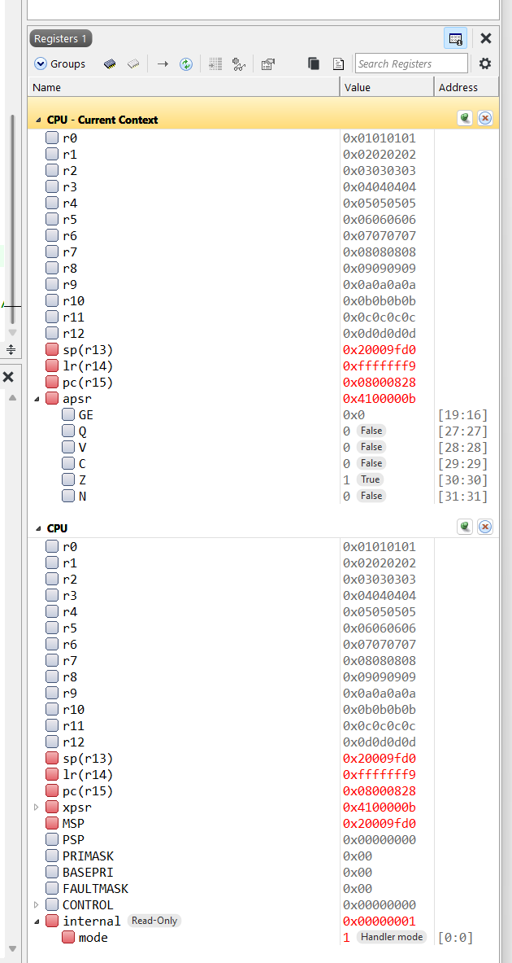
e.g., Demo of Exception Context
Expand this
See mode

Slide 31
e.g., Demo of Exception Context
asm volatile("ldr r0, =0x01010101");
asm volatile("ldr r1, =0x02020202");
asm volatile("ldr r2, =0x03030303");
asm volatile("ldr r3, =0x04040404");
asm volatile("ldr r4, =0x05050505");
asm volatile("ldr r5, =0x06060606");
asm volatile("ldr r6, =0x07070707");
asm volatile("ldr r7, =0x08080808");
asm volatile("ldr r8, =0x09090909");
asm volatile("ldr r9, =0x0A0A0A0A");
asm volatile("ldr r10, =0x0B0B0B0B");
asm volatile("ldr r11, =0x0C0C0C0C");
asm volatile("ldr r12, =0x0D0D0D0D");
//Do not change r13 - that is stack pointer!
asm volatile("ldr r14, =0x0E0E0E0E");

Slide 32
e.g., Demo of Exception Context
asm volatile("ldr r0, =0x01010101");
asm volatile("ldr r1, =0x02020202");
asm volatile("ldr r2, =0x03030303");
asm volatile("ldr r3, =0x04040404");
asm volatile("ldr r4, =0x05050505");
asm volatile("ldr r5, =0x06060606");
asm volatile("ldr r6, =0x07070707");
asm volatile("ldr r7, =0x08080808");
asm volatile("ldr r8, =0x09090909");
asm volatile("ldr r9, =0x0A0A0A0A");
asm volatile("ldr r10, =0x0B0B0B0B");
asm volatile("ldr r11, =0x0C0C0C0C");
asm volatile("ldr r12, =0x0D0D0D0D");
//asm volatile("ldr r13, =0x0E0E0E0E");
asm volatile("ldr r14, =0x0F0F0F0F");
asm volatile("nop");
asm volatile("nop");
asm volatile("nop");
asm volatile("nop");
asm volatile("ldr r13, =0x20001000");
asm volatile("nop");
asm volatile("nop");
asm volatile("nop");
asm volatile("nop");

Slide 33
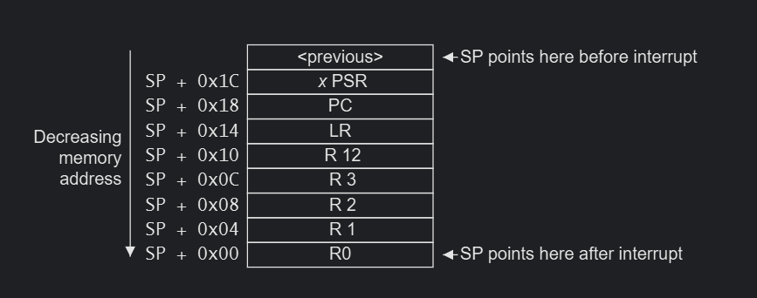
Exception Stack Register

Slide 34
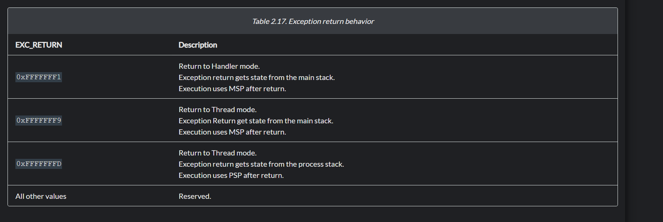
What is that LR Value?
https://developer.arm.com/documentation/dui0552/a/the-cortex-m3-processor/exception-model/exception-entry-and-return

Slide 35
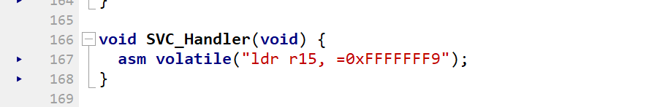
e.g., Demo of Loading PC Directly

Slide 36
Demo Summaries (Hopefully)
What registers went onto stack:
R0, R1, R2, R3, R12, R14 (LR), Return Address, Status Register (PSR)
What is value in LR?
0xfffffff9 → Special value indicating return mode
Only two stack pointers in Cortex-M

Slide 37
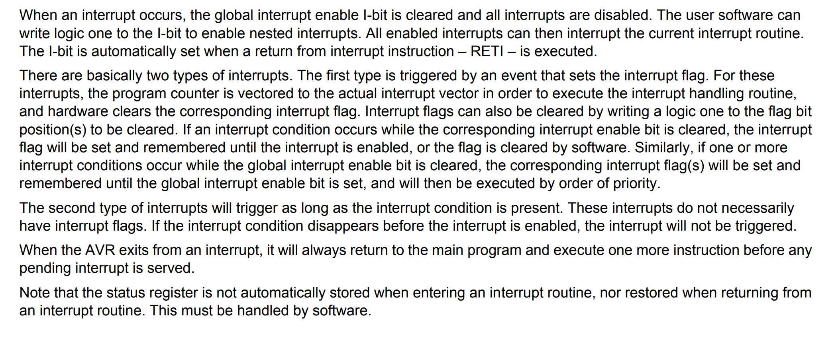
e.g., AVR Interrupt Differences
Datasheet Interrupt Section – READ FOR A NEW DEVICE

Slide 38
e.g., AVR Interrupt Differences
AVR does NOT save anything for you:
Not even the status register
Pushes the return address to the stack only, everything else is up to you.
As you use different devices be aware that there is few “universal truths”.

Slide 39
Summary
Interrupts are external to CPU, normally asynchronous.
Exceptions are generated by the CPU, normally synchronous.
Interrupts/Exceptions use a vector table to tell the CPU where execution should pass.
Normally some level of hardware support to save/restore context
May be minimal (AVR saving only return address) or more complete (Cortex-M saving multiple registers)

